Slide 1
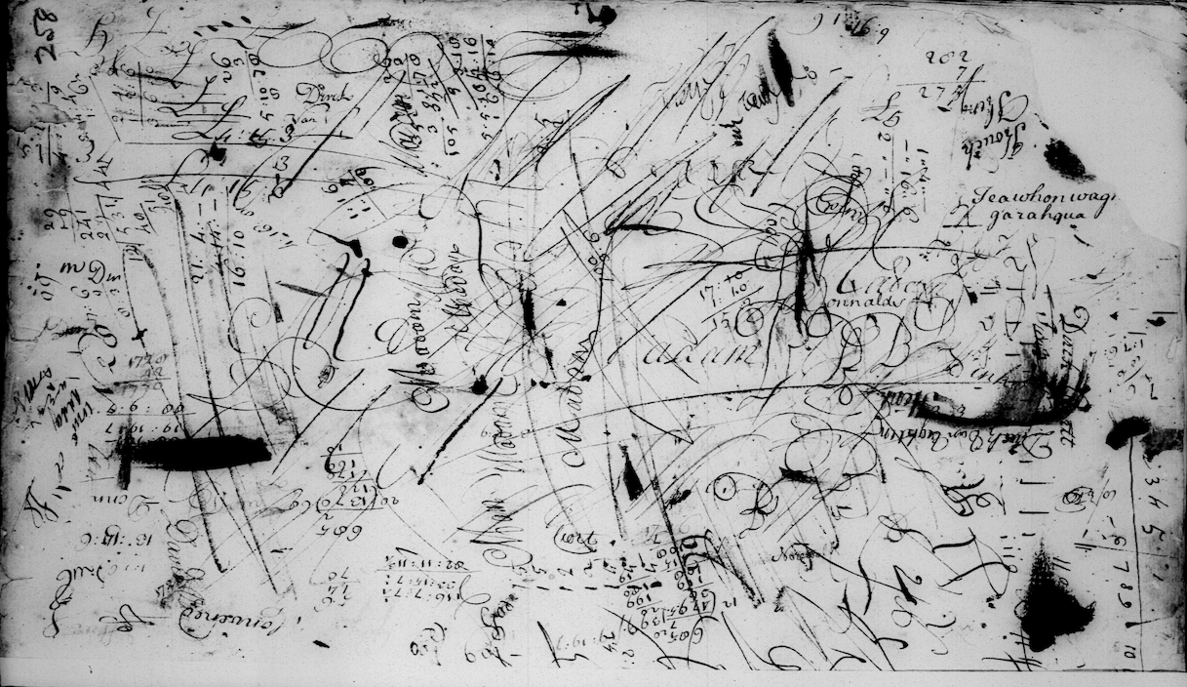
The Commissioners of the
Indian Affairs at Albany and Their Growing Online Presence
Ann H. Hunter, Independent Scholar
Conference on Iroquois Research
October 2018

Slide 2
Thank You
To the Seneca people whose land we are on,
To the organizers of the Conference on Iroquois Research,
To Jon Parmenter and Cornell University library for making high quality images of the commissioners’ records available,
To the clerks, copyists, librarians, archivists, microfilm technicians, digitizers and others who have enabled the records to survive through the centuries,
And to the audience for your interest in this subject.

Slide 3
Who Were the Commissioners of Indian Affairs?
When Dutch traders first came to what is now New York, they established diplomatic relations with the native peoples there.
In the area around Manhattan, the West India Company took an aggressive approach that led to a series of wars.
On the upper Hudson in the vicinity of what is now Albany, things developed differently.
The Dutch did not have a strong military presence.
All parties wanted to trade.

Slide 4
Who Were the Commissioners of Indian Affairs- cont.
  Dutch traders and farmers learned the languages and diplomatic protocols required to trade and live in close proximity with their Mohawk, Mohican, Munsee, and Abenaki neighbors.
  The Dutch became especially close allies with the Mohawks.
  In many ways the Dutch villages functioned like another group of small communities in the networks of communities that were already there.

Slide 5
Who Were the Commissioners of Indian Affairs- cont.
  The Dutch, Mohawks, and other groups interacted using indigenous practices:
    Regular meetings to renew positive relations
    Use of wampum,
    Exchange of gifts;
    Condolence rituals,
    Honorary kinship terms like brother, father, “child of this government,”
    Formal procedures for ensuring that people from different groups listened to each other, considered what the other side had said, and repeated it before responding.
  Dutch court officials added the European practice of keeping written records of the more important meetings.

Slide 6
Who Were the Commissioners of Indian Affairs- cont.
When the English took power in 1664, they relied on Dutch traders as interpreters and diplomats to forge their own agreements with the Iroquois and other groups.
After a brief shift back to Dutch rule in 1673-1674, Sir Edmund Andros took power for the English again.
Andros used Albany officials as his agents to renew the English relationship with the Iroquois and other groups.
Andros appointed Robert Livingston as Secretary of Indian Affairs to keep systematic records and translate them into English from Dutch.
Thus began the official records of Indian Affairs, which start in 1677.

Slide 7
Who Were the Commissioners of Indian Affairs- cont.
In 1686, Albany’s charter gave it a monopoly on the Indian trade, ensuring that Albany officials maintained economic as well as diplomatic ties to native people.
In 1696, Governor Benjamin Fletcher appointed New York’s first official commissioners of Indian Affairs. All of them were Dutch officials from Albany.
Subsequent governors continued the practice and the group became known as the ”Commissioners of the Indian Affairs at Albany” with occasional variations.
The number of members varied, but most continued to be chosen from Albany Dutch families.
They were charged with representing the British interest, but in practice they continued to see things from Albany’s point of view, which
  Reflected generations of close relationships with native people,
  Prioritized the well being of their citizens more than advancing the cause of empire.

Slide 8
Who Were the Commissioners of Indian Affairs – cont.
The Commissioners of Indian Affairs functioned until 1755, when the British replaced them with a centralized Indian Department that reported directly to the British Crown instead of to New York.
Sir William Johnson, long a critic of the Dutch commissioners, finally realized his long held goal of replacing them when he became Superintendent of Indian Affairs for the Northern Colonies.
He took possession of the records, which by then were organized into four volumes of “minute books.”

Slide 9
History of the Records
When the Johnson family fled to Canada at the beginning of the American Revolution, they took the records with them.
If the records had been left behind, they would likely be in the NYS Archives. Or they might have burned in the 1911 fire.
Instead they remained in the custody of the British Indian Department and then Canada’s Department of Indian Affairs.
In 1907 they were transferred to Canada’s National Archives.

Slide 10
History of the Records, cont.
At some point before 1907 the first two volumes were lost, but before they were lost, someone took rough notes on them under the heading “Schedule of propositions made by the Indians and answers given to them, 1677-1714.” (Some think the first two books were lost earlier, but the style of the notes suggests they were written in the mid 19th century.)
Copies of some portions (probably no more than 15-20%) were sent to England and later collected and printed in the Documents Relative to the Colonial History of New York
Peter Wraxall made an Abstraction of the records through 1748.
The second two volumes, which cover the period from 1723-1748, and the ”Schedule of Propositions …” notes from the first two volumes were microfilmed in the 1950s.
Later the microfilm was digitized.

Slide 11
Use of the records
The records have mainly been used by people writing full length histories of the Six Nations.
  The book that makes the most use of the remaining original records is Jon Parmenter’s thesis, At the Wood’s Edge: Iroquois Foreign Relations, 1727-1768.
  His article, “Onenwahatirighsi Sa Gentho Skaghnughtudigh”: Reassessing Haudenosaunee Relations with the Albany Commissioners of Indian Affairs, 1723–1755 in Nancy L. Rhoden (ed.), English Atlantics Revisited: Essays Honouring Ian K. Steele, McGill-Queen’s University Press, 2007 is an excellent introduction to the commissioners themselves.
Thomas Stahlhut’s recent thesis, Creating Borderlands Authorities: The Albany Commissioners for Indian Affairs and the Iroquois Nations, 1691-1755 examines how the Commissioners of Indian Affairs played a role in shaping international developments, both indigenous and European.

Slide 12
Uses of the records – cont.
The commissioners’ records also contain much information that remains underused, especially on:
  Kahnawake and the other communities that became the Seven Nations of Canada
  The history of New York and Albany, including information on many individual Dutch settlers
  The Mohicans, Schaghticoke, Abenaki, and other “Eastern Indians”
  The migrations of native peoples during the 17th and 18th centuries
  Trade
  Slavery and captivity
Online access makes this information accessible to a wider range of scholars as well as the general public.

Slide 13
Important Aspects of the Records
They are a continuous record over time focused on native people.
They provide new perspectives on non-native people.
They include examples of how indigenous traditions functioned in practice.
The records are full of stories:
  Interesting characters come and go,
  Plots take unexpected twists and turns,
  Events are dramatic and sometimes tragic,
  There are moments of comic relief.

Slide 14
The Records Go Online
Digitized images of the microfilm are now available online through two websites:
  Heritage Canada: http://heritage.canadiana.ca/view/oocihm.lac_reel_c1220/7?r=0&s=1
  Cornell University Library: https://ecommons.cornell.edu/handle/1813/57183
There are thousands of these individual images of handwritten text with no index. They are out of chronological order in places. There are also some contemporary copies inserted in a way that further confuses matters.
Thus they are difficult to work with, let alone search systematically.

Slide 15
Why Another Website?
I started looking at these records a few years ago in the hope of going deeper into the history of Mohawk land transactions in the 17th and 18th centuries.
They were so frustrating to work with that I began to transcribe them, starting with the “Schedule of Propositions Made By the Indians” which I did a presentation on two years ago.
I used WordPress to create a website to share the work.
The website has become a way to organize and better understand what is in the records.

Slide 16
Features of the Website
https://albanyindiancommissioners.com now includes:
Transcriptions
  The notes on the first two minute books entitled “Schedule of propositions made by the Indians and answers given to them, 1677-1714.” This material was very out of order chronologically. In order to make it comprehensible, the transcription has been rearranged to put it into chronological order. I did a presentation on this portion at the 2016 CIR. The slides are available on the website.
  Minute Book 3, 1723-1732, in original order.
  1723-1731 year by year in chronological order
Summaries month by month for 1723-1727.
Tag cloud and categories for the summaries
Tags and categories as well as the transcriptions are access points that draw web traffic
Links to other sources
Presentations from previous conferences
Occasional comments, thoughts, and related information
Ongoing corrections and revisions

Slide 17
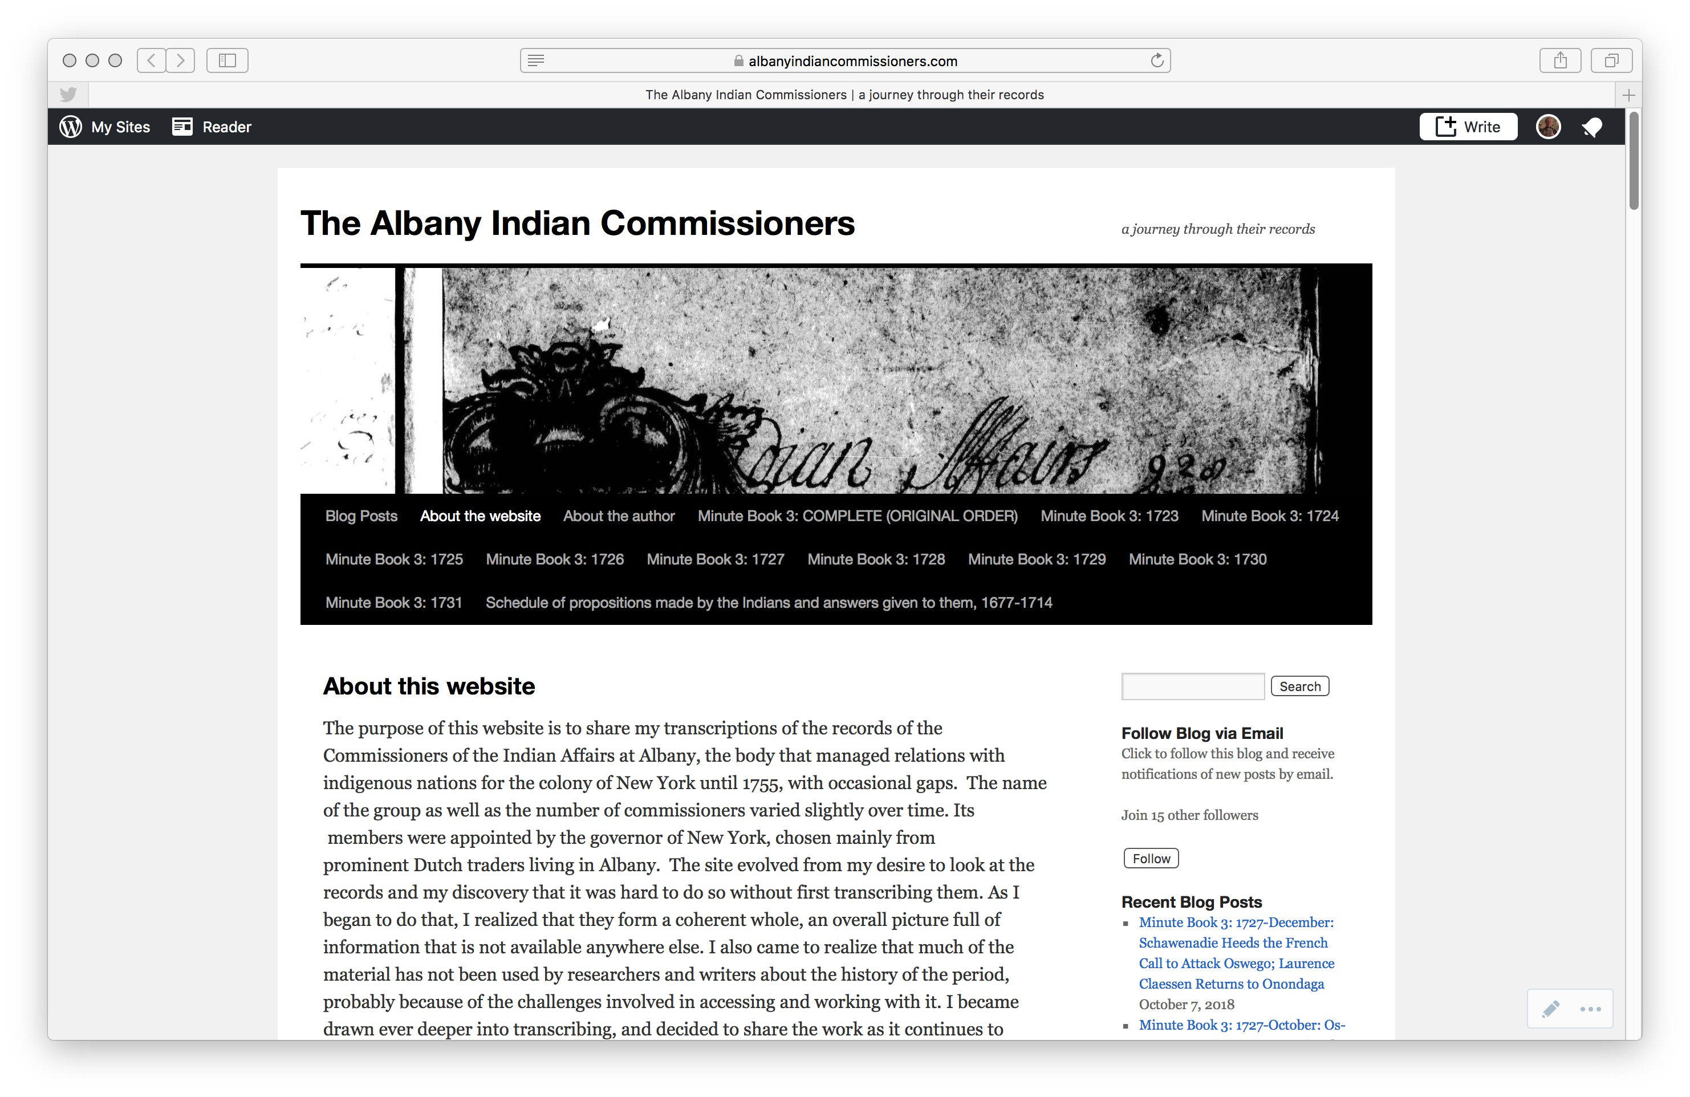

Slide 18
Where to go next
Text Encoding
Print Publication
Full Index
Glossary
All would need to be done by an institution with considerable resources
My own plan
  Finish transcribing through 1755
  Create summaries for the Schedule of Propositions notes
  Let people know about the existing resources
  Encourage exploration of these materials as a way to integrate the disparate categories of “Early American History.”
GO TO SITE
https://albanyindiancommissioners.com

